Slide 1
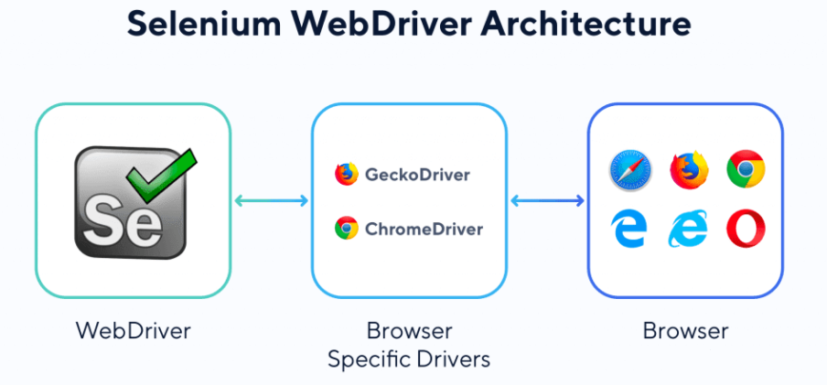
Selenium Webdriver
Open source automation tool used for automating web-based application testing.
How to install selenium
PYTHON - Download Python | Python.org
SELENIUM - in cmd type - pip install selenium
WEBDRIVER - https://chromedriver.chromium.org/downloads
PYCHARM - https://www.jetbrains.com/pycharm/download/#section=windows

Slide 2
Navigation
driver.get(‘URL’)
Locators
Find_element_by_ (id, name, link_text, class_name, css selector, xpath)
Actions
.send_keys() = to enter input value in a blank
.click() = to give click command
.clear() = to clear the input field
.text = to copy the text

Slide 3
CSS Selector (Locator)
FROM | SYNTAX
Attribute & Value | tagname[attribute = ‘value’]
ID | tagname#IDvalue
Class | tagname.classvalue
Note: tagname is optional
To check the uniqueness from console, syntax => $(“tagname[attribute=’value’]”)

Slide 4
XPATH (Locator)
FROM | SYNTAX
Attribute & Value | //tagname[@attribute = ‘value’]
text | //tagname[text() = ‘type text here’]
Parents to child | //tagname[@attribute = ‘value’]/tagname
Parents to last child | //tagname[@attribute = ‘value’]/tagname[last()]
Grand parent to child | //tagname[@attribute = ‘value’]/tagname/tagname
Child to any ancestor | //tagname[@attribute = ‘value’]/ancestor::tagname[@attribute = ‘value’]
Starts with | //tagname[starts-with(@attribute,’starting values’)]
contains | //*[contains(@attribute,’value’)]
Starts with and contains | //tagname[starts-with(@attribute,'starting values') and contains(@attribute,’value')]
To check the uniqueness from console, syntax => $x(“//tagname[@attribute=’value’]”)

Slide 5
Multiple Checkboxes
Create one xpath which will be common for all checkboxes then use for loop to click all
Static Dropdown (select tagname)
Import Select object, give locator inside it, keep this in one variable and use Select functions
Dynamic Dropdown
Create xpath which will be common for all suggestions, then use for loop to select the particular
Pop up Alert
popup = driver.switch_to_alert()

Slide 6
File Upload
Locate element with tagname “input” then in the send_keys, give the complete path of the file.
Implicit Wait
driver.implicitly_wait()
Explicit Wait
first import By, expected_conditions and WebDriverWait then use explicit wait with conditions
Mouse Hover, Double-click, Right-click
Import ActionChains

Slide 7
Multiple Windows, Tabs
driver.switch_to_window(driver.window_handles[x])
Frames
driver.switch_to_frame('x'), x can be id value, class value, name value or driver.find_element things also.
Get attribute
driver.find_element_by_xpath(" ").get_attribute("attribute name")

Slide 8
Pytest Framework
pip install pytest, Python file name & function name should start with test_
Fixtures & Conftest.py
Conftest.py to store the fixture & html report modifications
Pytest Html Report
pip install pytest-html (to download the package) , –html=report.html (to download the report)
Logs (Code on next slide)
Log is defined as records in programming.

Slide 9
logger = logging.getLogger()
filehandler = logging.FileHandler("logfile.log")
formatter = logging.Formatter('%(asctime)s: %(levelname)s: %(module)s: %(funcName)s: %(message)s', datefmt='%d/%m/%Y %I:%M:%S %p')
filehandler.setFormatter(formatter)
logger.addHandler(filehandler)
logger.setLevel(logging.DEBUG)
logger.debug("Debug message")
logger.info("Information regarding the test case")
logger.warning("Test case pass but with a Warning message")
logger.error("Test case fail")
logger.critical("Important test case fail on which other test case depends")

Slide 10
Scrolling
driver.execute_script("window.scrollTo(0, X)") => X is the vertical height measured in pixels
driver.execute_script("window.scrollTo(0, document.body.scrollHeight);") => scroll to the last of the page
driver.execute_script("arguments[0].scrollIntoView();", X) => scroll to specific element X
y = 1000
for step in range(0,50):
driver.execute_script("window.scrollTo(0, "+str(y)+")")
y += 1000
time.sleep(1)
Pytest Parametrize
@pytest.mark.parametrize('count' ,[1,2,3])

